Slide 1

Project
Surprise Housing Price prediction
& Sales
Submitted by:-
Deepak Vyas

Slide 2
Agenda
Housing Price Prediction
Problem Overview
Dataset Overview
Data Preparation
Proposed Models
Evaluation
Conclusion

Slide 3
A US-based housing company named Surprise Housing has decided to enter the Australian market. The company uses data analytics to purchase houses at a price below their actual values and flip them at a higher price. The company wants to know
Build a regression model using regularisation in order to predict the actual value of the prospective properties and decide whether to invest in them or not. Determine the optimal value of lambda for ridge and lasso regression. This model will then be used by the management to understand how exactly the prices vary with the variables They can accordingly manipulate the strategy of the firm and concentrate on areas that will yield high returns. The model will be a good way for the management to understand the pricing dynamics of a new market.
Goal
Overview
Which variables are significant in predicting the price of a house, and How well those variables describe the price of a house. Based on various market surveys, the consulting firm has gathered a large dataset of different types of cars across the American market.

Slide 4
Agenda
Housing Price Prediction
Problem Overview
Dataset Overview
Data Preparation
Proposed Models
Evaluation
Conclusion

Slide 5
Dataset overview
Data contains 1460 entries each having 81 variables.
Data contains Null values.
Data contains numerical as well as categorical variable.
Data File is in csv format

Slide 6
Agenda
Housing Price Prediction
Problem Overview
Dataset Overview
Data Preparation
Proposed Models
Evaluation
Conclusion

Slide 7
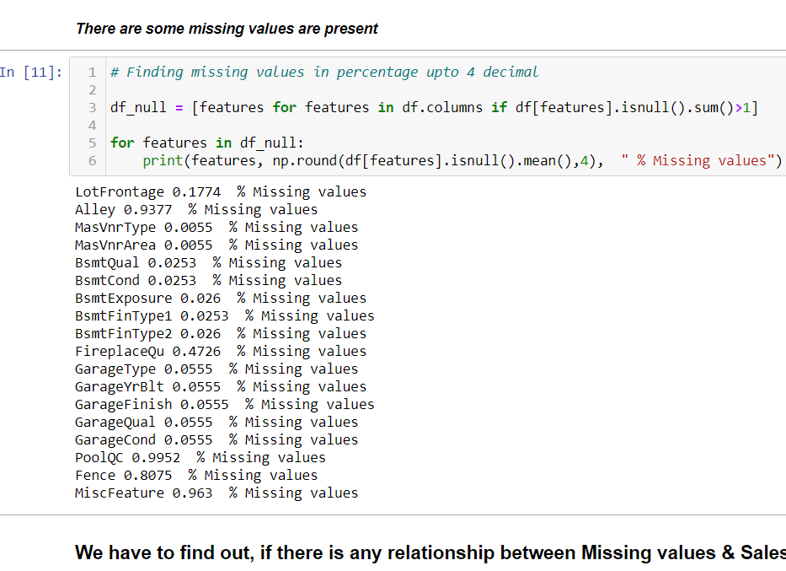
We have some missing values

Slide 8
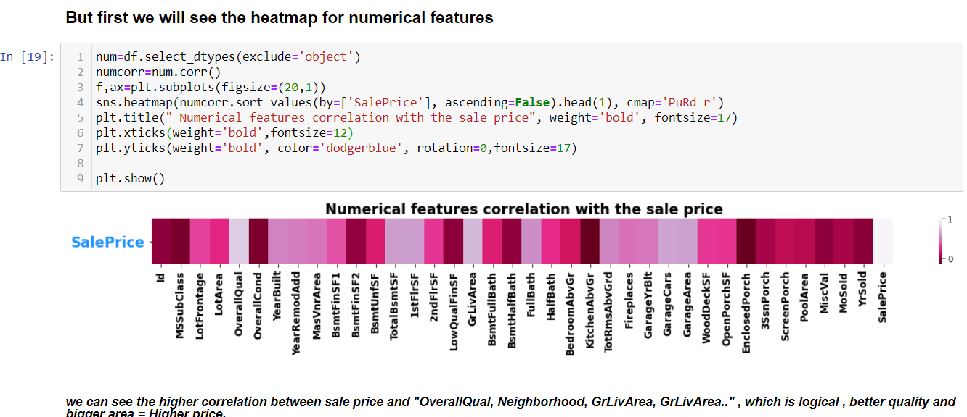

Slide 9
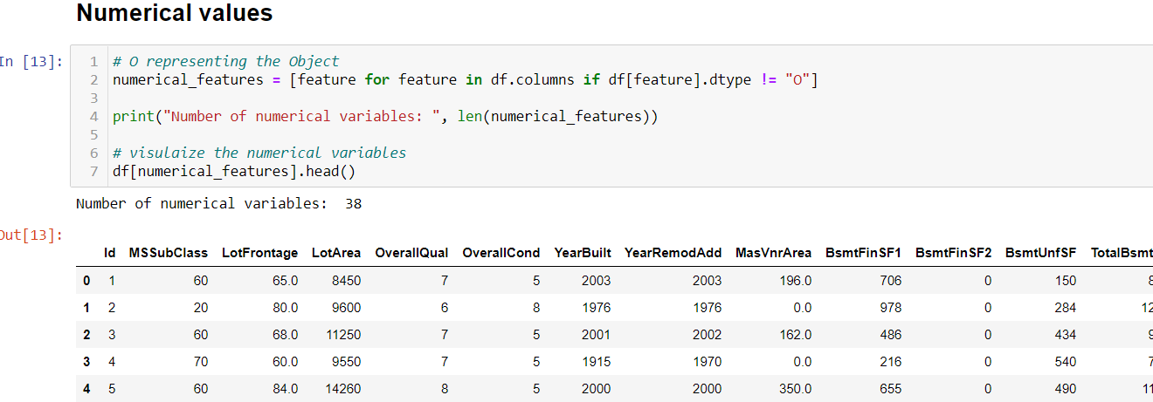
Agenda
Numerical Features
Discrete Features = 17
Continuous Features = 16
Temporary Features = 4
Numerical Features

Slide 10
Agenda
Housing Price Prediction
Problem Overview
Dataset Overview
Data Preparation
Proposed Models
Evaluation
Conclusion

Slide 11
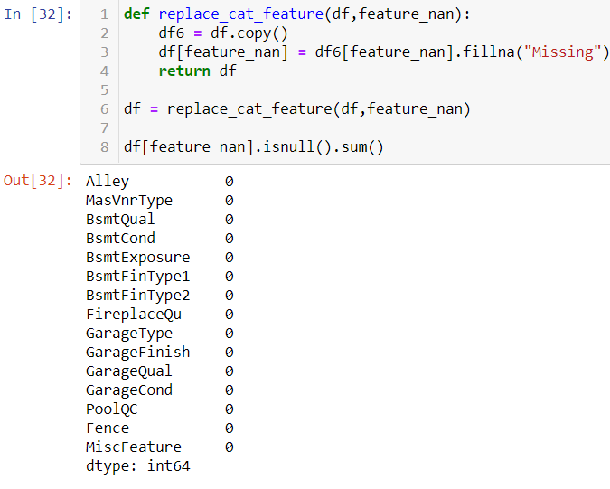
Feature engineering
Treating Categorical features which are missing

Slide 12
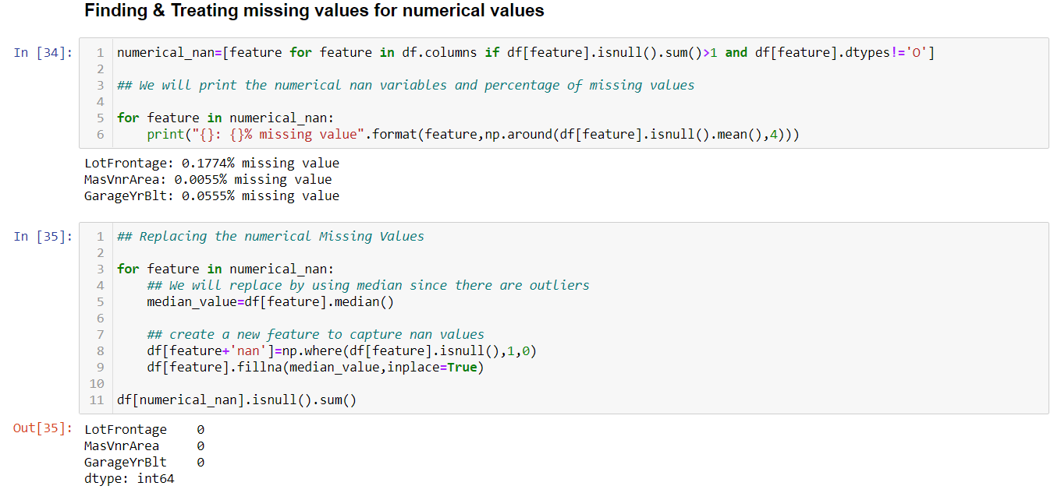
Feature engineering

Slide 13
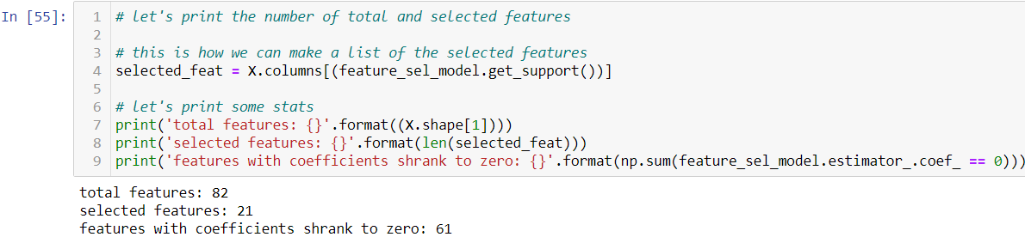
Feature selection we have 21 feature

Slide 14
Agenda
Housing Price Prediction
Problem Overview
Dataset Overview
Data Preparation
Proposed Models
Evaluation
Conclusion

Slide 15
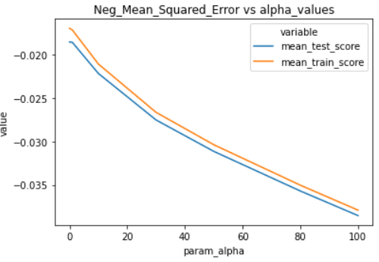
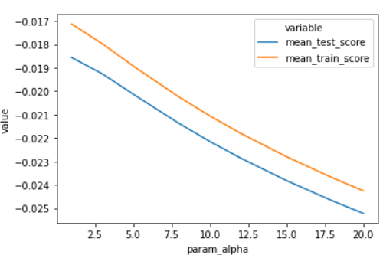
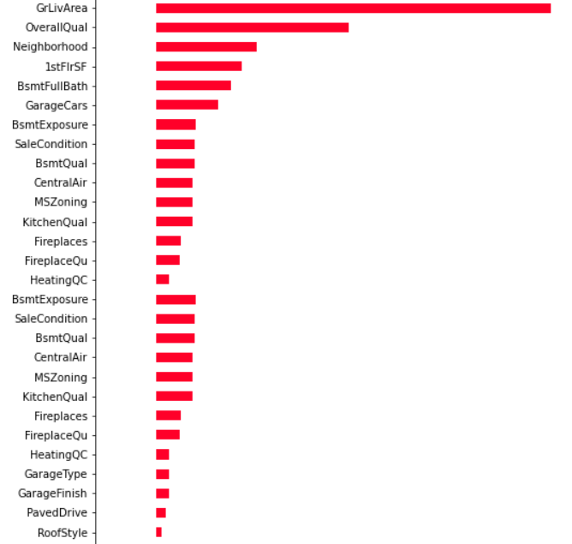
ML Model
Ridge Regularization
Without tuning
With tuning
These features having positively affect the target feature

Slide 16
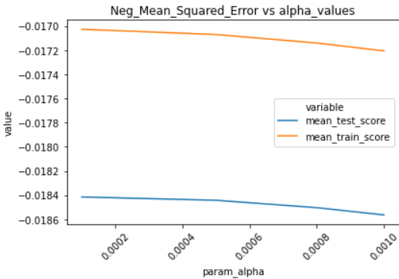
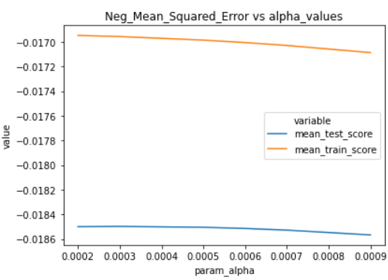
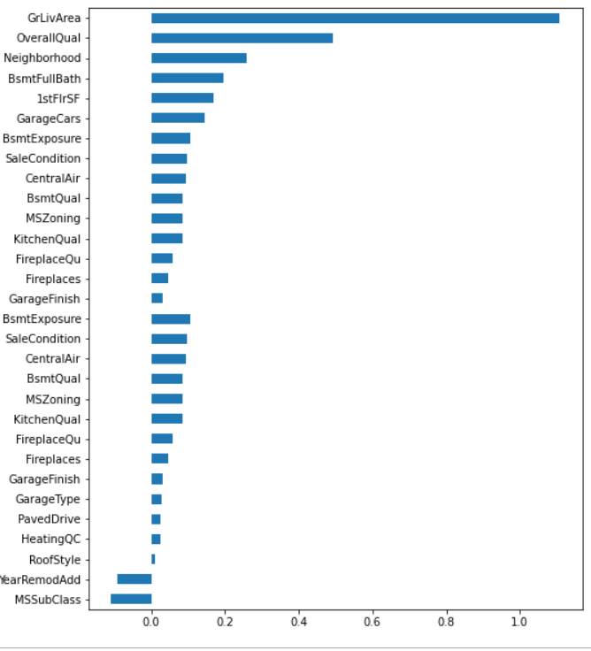
ML Model
Lasso Regularization
Without tuning
With tuning
These are the features affecting positively & negatively

Slide 17
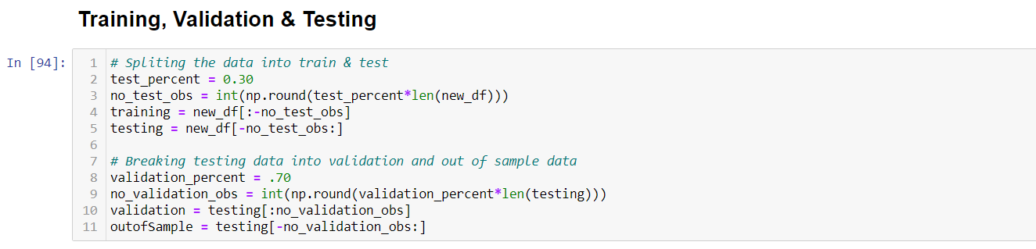
DL MODEL
We are going to use our clean data
Data divided into 3 parts train , test, validate

Slide 18
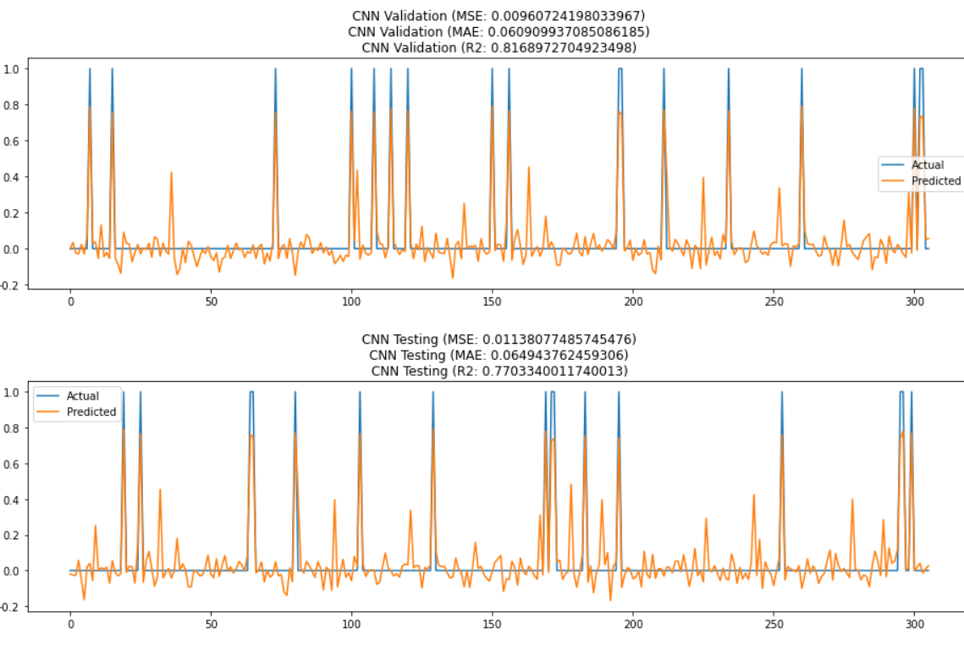
CNN
MODEL
Comparison of actual and predicted values for Validation and testing

Slide 19
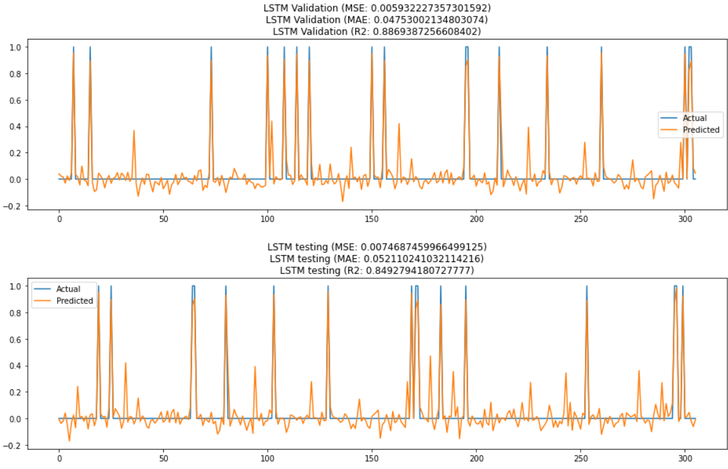
LSTM
MODEL
Comparison of actual and predicted values for Validation and testing

Slide 20
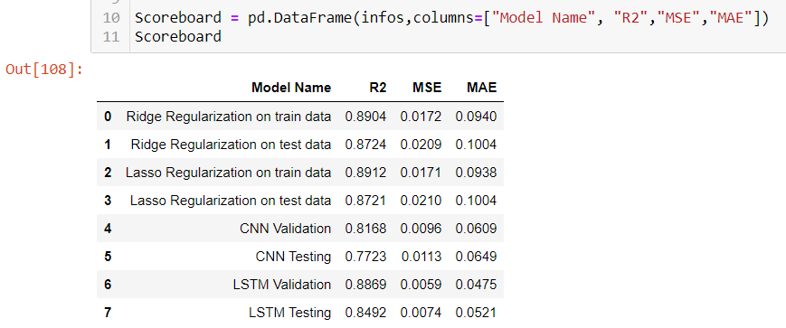
Now we are going to put all models output into a dataframe for better visualization

Slide 21
Agenda
Housing Price Prediction
Problem Overview
Dataset Overview
Data Preparation
Proposed Models
Evaluation
Conclusion

Slide 22
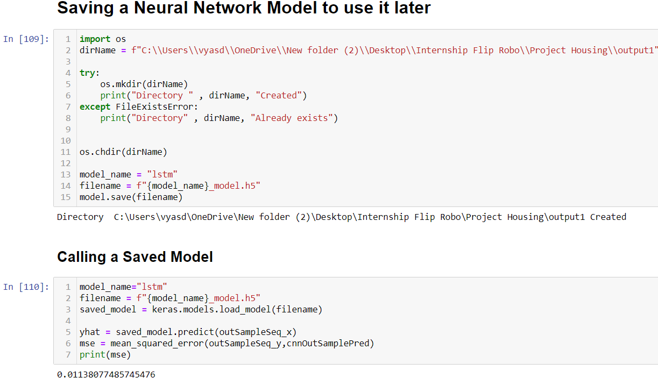
Finally we are saving & calling our model LSTM, which is little bit better from our ML model

Slide 23
CONCLUSION:
I check the data first and uploaded the data in jupyter notebook and than I visualize the features ,Perform the preprocessing in the data and understand the relationship between different features.
I used train-validation split to evaluate the model effectiveness to predict the target values.
At the end I applied the four predictive models in the data.
I started with ML MODEL :
1) Lasso
2) Ridge
DL MODEL:
1) CNN
2) LSTM
After comparison all models, we find LSTM is slightly better than all other model, we are going to save LSTM DL Model.

